Slide 1
Unit 3
COMBINATIONAL CIRCUITS

Slide 2
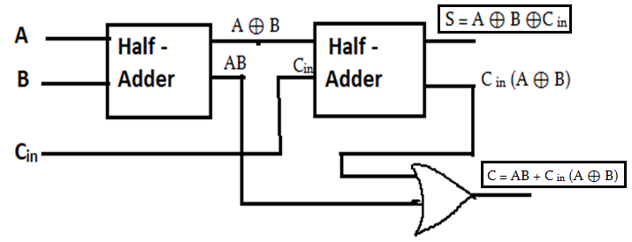
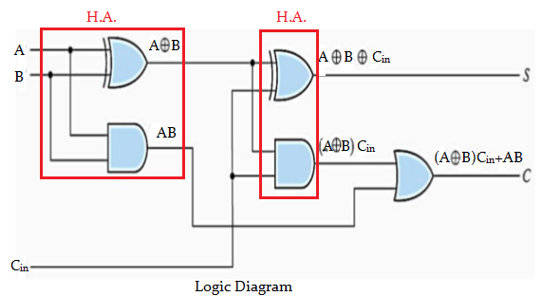
Full Adder using Half Adder
Block Diagram

Slide 3
The Boolean expression for Sum and Carry is as,
Sum = A ⊕ B ⊕ C
Carry = AB + (A ⊕ B). C_{in}
= AB + ( AB’ + A’ B). C_{in}
= AB + AB’C_{in} + A’BC_{in}
= A (B + B’ C_{in}) + A’ BC_{in} HERE A+A’B=A+B
= A (B + C_{in}) + A’B C_{in}
= AB + AC_{in} + A’ BC_{in}
= AB + C_{in} (A + A’B)
= AB + C_{in} (A+B)
Carry = AB + AC_{in} + BC_{in}

Slide 4
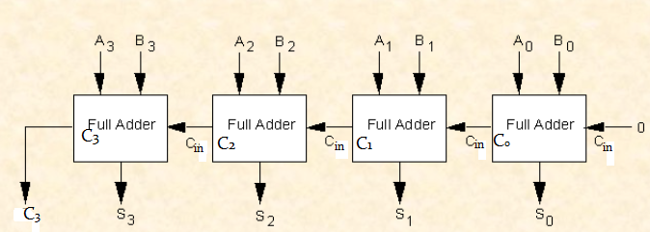
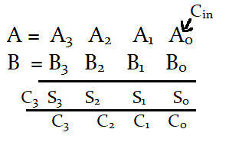
4-bit Parallel Adder using Full Adder

Slide 5
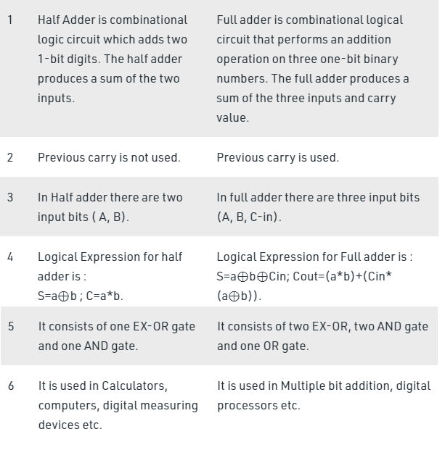
Comparision between Half Adder & Full Adder
Half Adder Full Adder

Slide 6
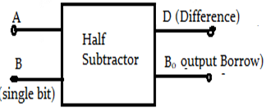
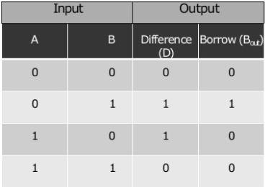
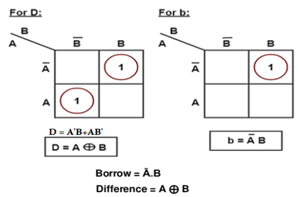
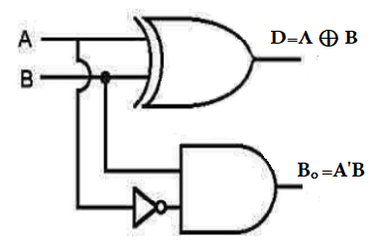
HALF SUBTRACTOR
Half subtractor is a combinational circuit with two inputs and two outputs (difference and borrow).It produces the difference between the two binary bits at the input and also produces a output (borrow) to indicate if a 1 has been borrowed. In the subtraction (A-B) A is called as minuend bit and B is called as subtrahend bit.
1.Block Diagram
2. Truth Table
3. Solving truth table using K-map
4. Logic Diagram

Slide 7
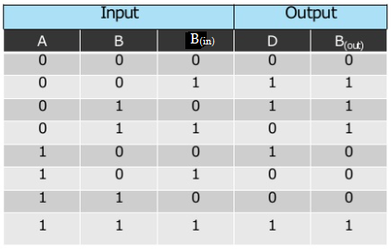
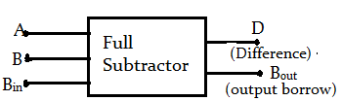
FULL SUBTRACTOR
The Full Subtractor is a combinational circuit with three inputs A, B & B_{in} and tw0 output D & B_{out} .A is minuend , B is subtrahend, B_{in} is the borrow produced by the previous stage. D is the difference output and B_{out} is the borrow output.
1.Block Diagram
2. Truth Table

Slide 8
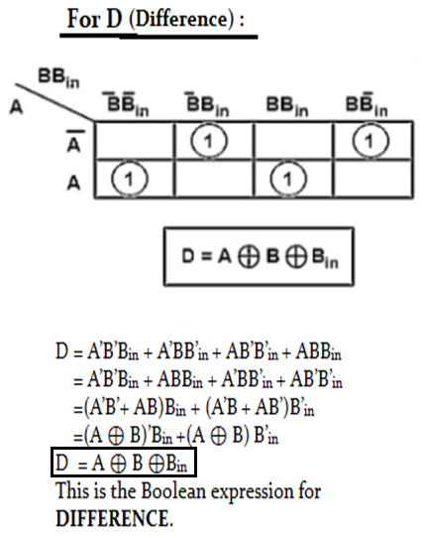
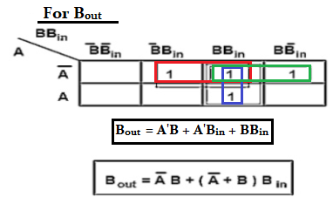
3 .Solving truth table for Difference & Borrow using K-Map

Slide 9
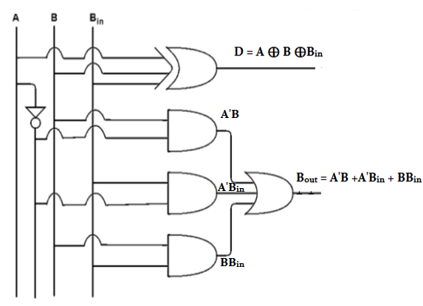
4. Logic Diagram

